Slide 1

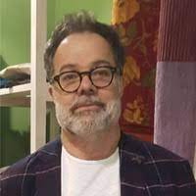
Seminario DISTAR
Christian Gorini,
Institut des Sciences de la Terre de Paris. Sorbonne Université (F)
Titolo:
The Messinian salinity crisis; a review of key seismic stratigraphy observation and kinematic reconstructions
26 Gennaio , Aula GEO1
14 (Rome time zone, GMT+1)

